Slide 1
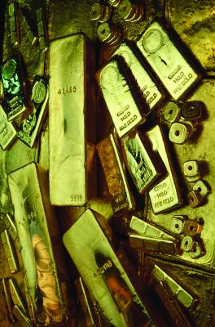
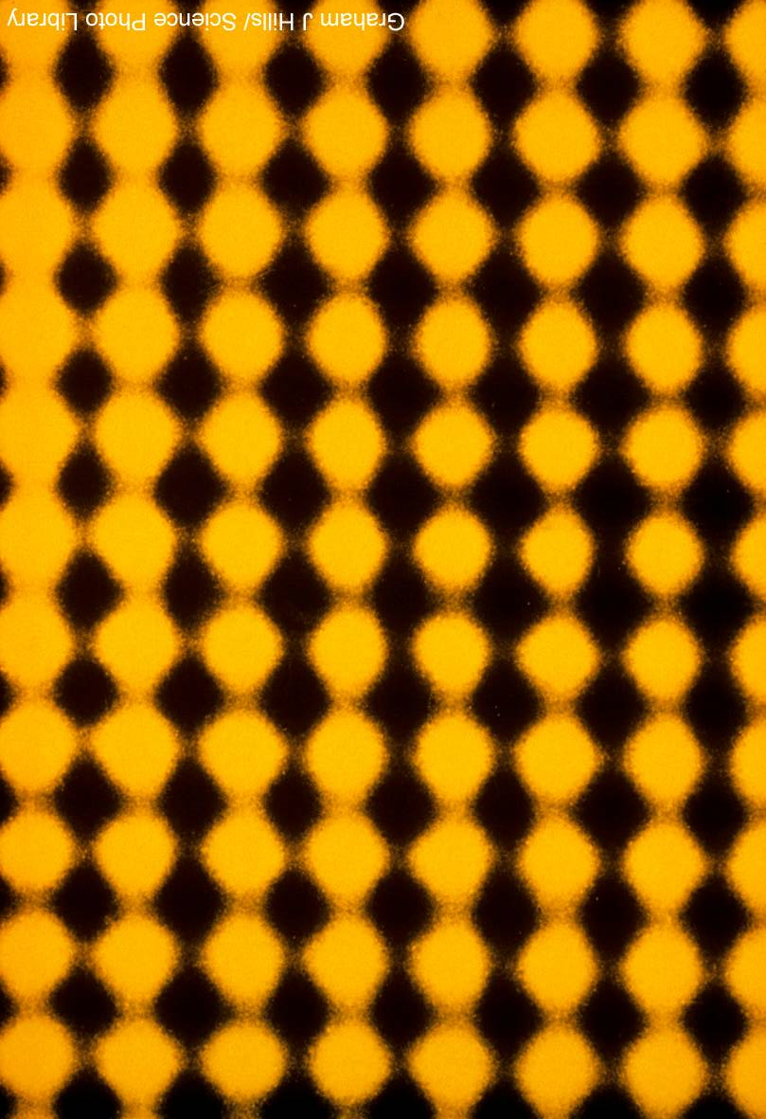
Atomic Structure
Unit 2
Lesson 1

Slide 2
Today’s Aim
Unit 2
Lesson 1
By the end of this lesson I will be able to
describe the structure of the atom
deduce the electronic arrangement of the first 20 elements

Slide 3

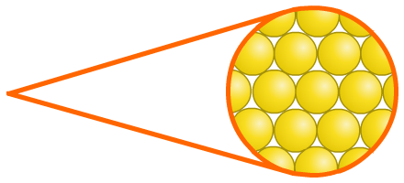
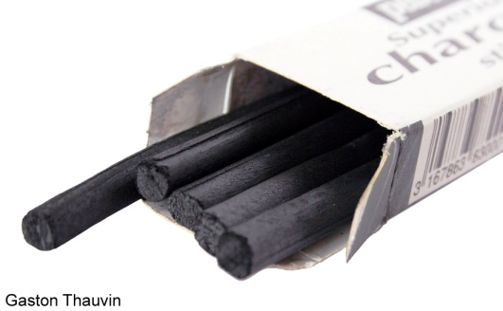
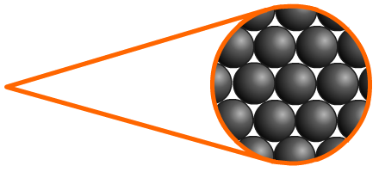
There are about 100 different elements
Elements are the simplest substances. There are about 100 different elements. Each element is made up of very tiny particles called atoms, and each element is made up of just one particular type of atom, which is different to the atoms in any other element.
Gold is an element made up of only gold atoms.
Carbon is an element made up of only carbon atoms.

Slide 4
Gold Atoms

Slide 5



What are atoms made of?
For some time, people thought that atoms were the smallest particles and could not be broken into anything smaller.
Scientists now know that atoms are actually made from even smaller particles. There are three types:
proton
neutron
electron

Slide 6
Activity
Use this information to complete page 6
Protons have a positive electrical charge and are located in the centre of an atom – the nucleus. Neutrons are neutral and therefore have no electrical charge. They are also found in the nucleus. Both protons and neutrons have a relative mass of one. The electrons have a negative electrical charge. Unlike the other subatomic particles, electrons are found orbiting the nucleus in shells and have a mass of about 1/2000th of a proton/neutron. We sometimes call this ‘negligible’ as the mass is so small.

Slide 7
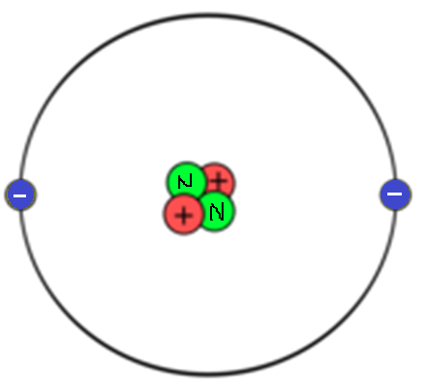
Check your diagram on page 6

Slide 8
Check your table on page 6
Particle | Relative charge | Relative mass
Proton | 1+ (positive) | 1
Neutron | 0 (neutral) | 1
Electron | 1- (negative) | 1/2000

Slide 9
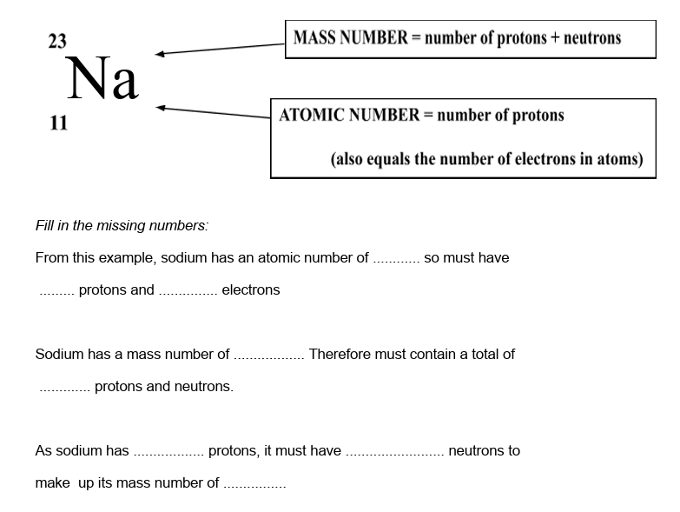
Fill in the missing number on page 7

Slide 10
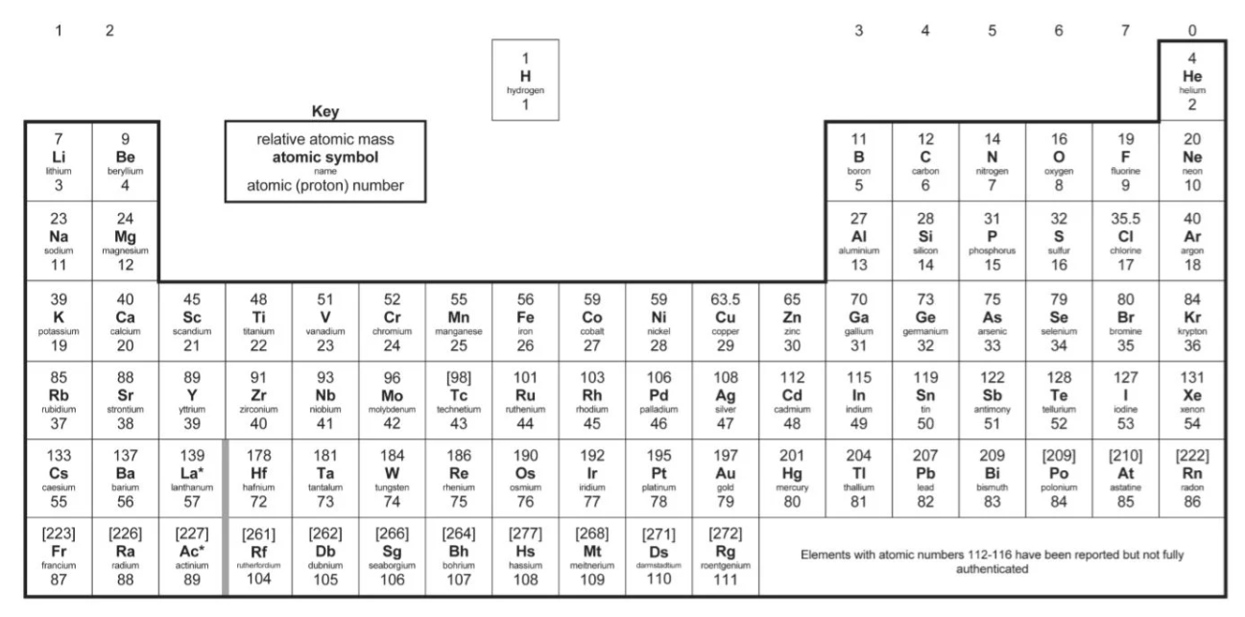
The Periodic Table of Elements

Slide 11
The Periodic Table
197
Au
The SYMBOL of the element
The NAME of the element
Gold
79

Slide 12
The simple ones
H
He
Li
Be
B
C
N
Hydrogen
Helium
Lithium
Beryllium
Boron
Carbon
Nitrogen
O
F
Ne
Mg
Al
Si
P
Oxygen
Fluorine
Neon
Magnesium
Aluminium
Silicon
Phosphorus

Slide 13
Less obvious ones
Na
K
Fe
Cu
Ag
Sodium
Potassium
Iron
Copper
Silver
Sn
Au
Hg
Pb
Tin
Gold
Mercury
Lead

Slide 14
The Periodic Table
Relative atomic mass (more on this next lesson)
197
Au
Gold
The ATOMIC NUMBER of the element
79

Slide 15
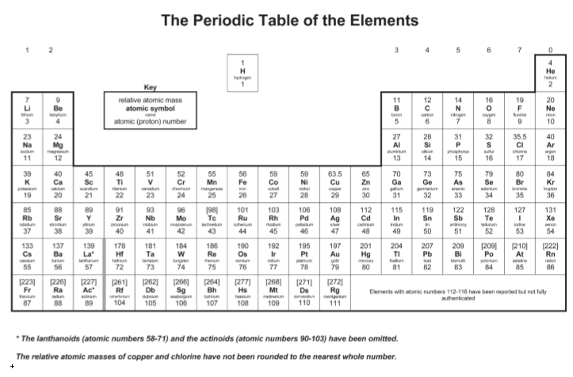
What does the key mean?
= number of protons
(and electrons. Sometimes
called the proton number)
The number of protons determines the element's identity (e.g., hydrogen has one proton, helium has two)

Slide 16

Patterns in the periodic table
The periodic table is arranged based on two things:
Atomic number - the number of protons in an atom.
Groups and periods - determined by the electronic configuration of atoms.
Notes:
Space for notes on page 10.

Slide 17
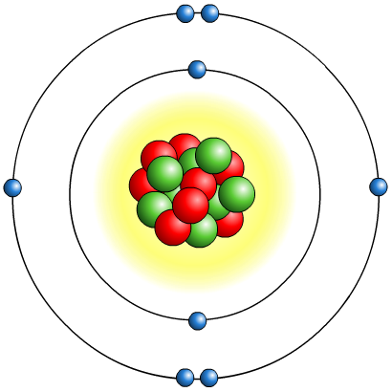
Review: the atom
The nucleus is:
made up of protons and neutrons
positively charged because of the protons
dense – it contains nearly all the mass of the atom in a tiny space.
Electrons are:
very small and light, and negatively charged
able to be lost or gained in chemical reactions
found thinly spread around the outside of the nucleus, orbiting in layers called shells.

Slide 18
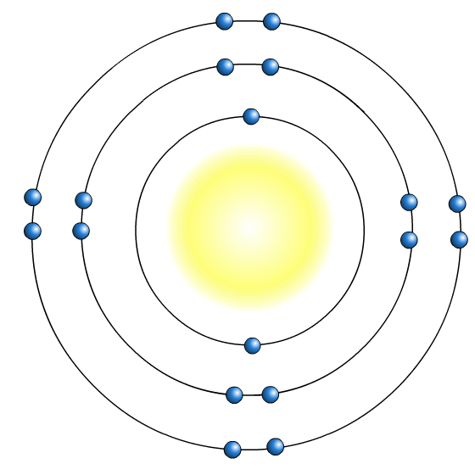
Shells
Electrons are arranged in shells (or energy levels) around an atom’s nucleus. Each shell has a maximum number of electrons that it can hold. Electrons will fill the shells nearest the nucleus first.
2nd shell holds
a maximum of
8 electrons
1st shell holds
a maximum of
2 electrons
3rd shell holds
a maximum of
8 electrons

Slide 19
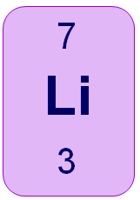
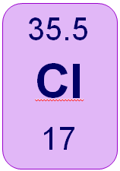
Drawing Electrons
Cl
Notes:
‹#›

Slide 20
Drawing Electrons
16
27
O
Al
13
8
Notes:
‹#›

Slide 21
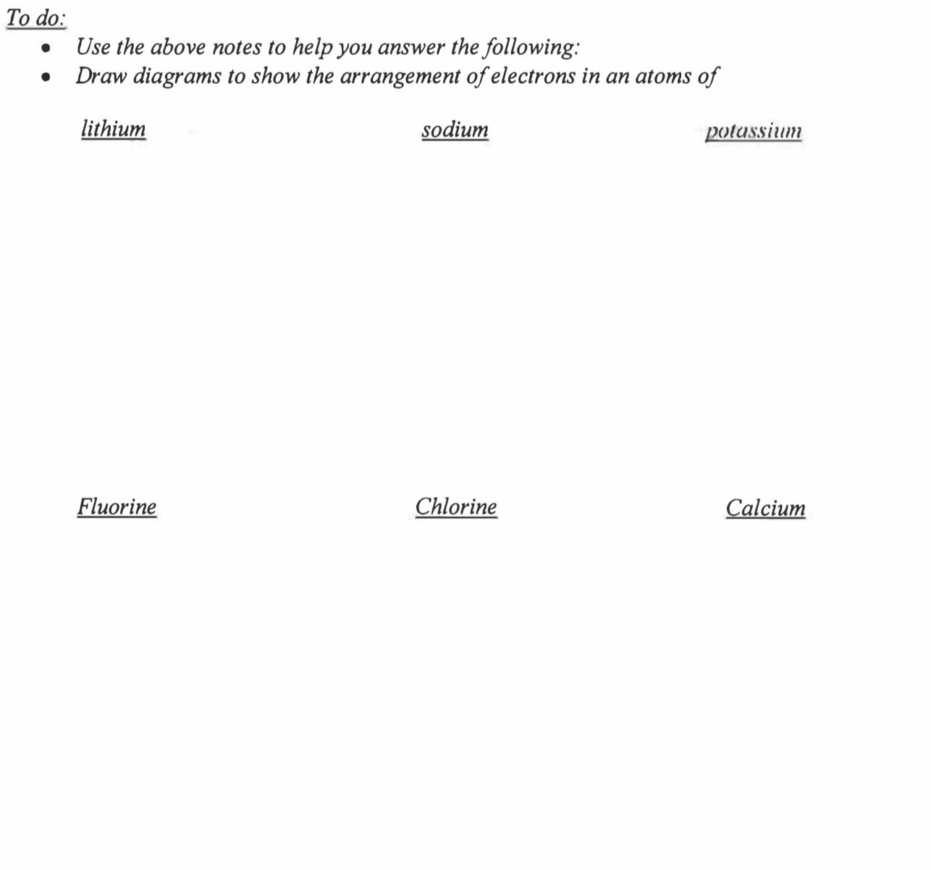
Complete all diagrams on page 8

Slide 22
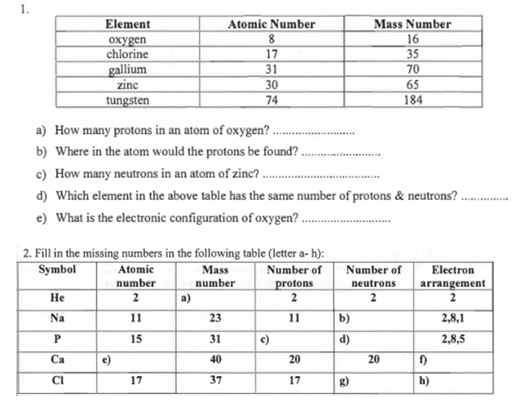
Answer all questions on page 9
8
nucleus
35
oxygen
2,6
4
12
15
16
20
2, 8, 8, 2
20
2, 8, 7

Slide 23
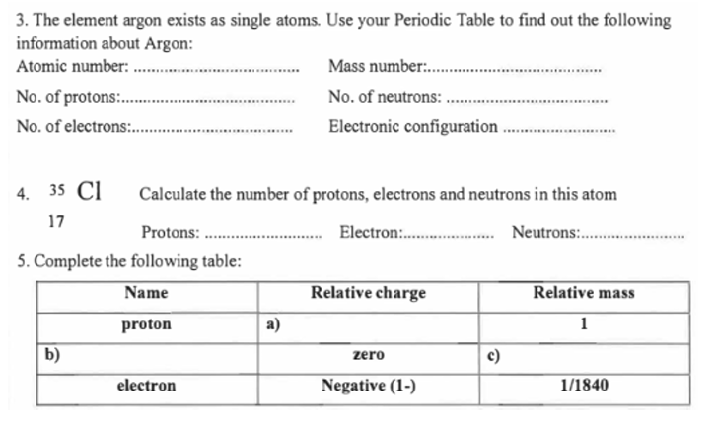
Answer all questions on page 9
18
40
18
22
18
2, 8, 8
arrangement
17
17
18
positive
neutral
1
1/2000

Slide 24
Electron trends in the periodic table
Trends down a group:
the number of outer shell electrons is the same;
the number of complete electron shells increases by one.
The number of a group is the same as the number of electrons in the outer shell (except for group 0 which have full outer shells)
Trends across a period:
the number of outer shell electrons increases by one;
the number of complete electron shells stays the same.
The number of a period is the same as the number of occupied shells.

Slide 25
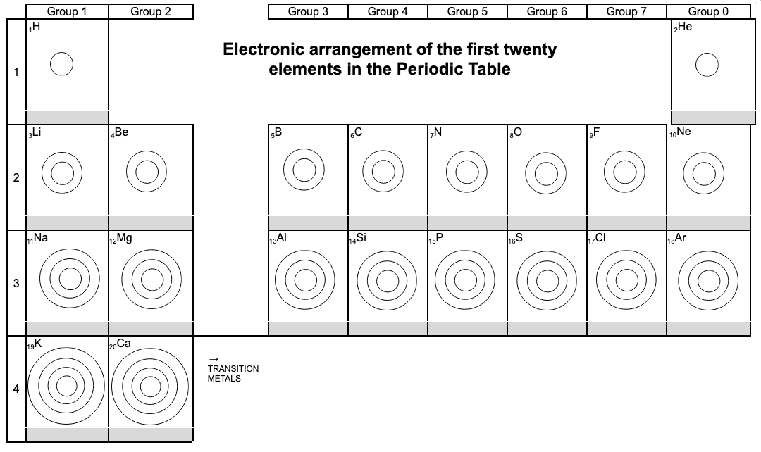
Complete all arrangements on page 11

Slide 26
Plenary: chemistry joke...
Question: why can’t you trust an atom?
Answer: they make up everything!

Slide 27

What you need to know
Unit 2
Lesson 1
Syllabus Content
1.15
know the structure of an atom in terms of the positions, relative masses and relative charges of sub-atomic particles.
1.19
understand how to deduce the electronic configurations of the first 20 elements from their positions in the Periodic Table.
My Learning

